Slide 1
Health Policy Issues
An Economic Perspective
Chapter 2

Slide 2
Chapter 2
How Much Should We Spend on Medical Care?

Slide 3
LEARNING OUTCOME
Examine how inefficiencies have contributed to rising healthcare costs, how increases might be limited in the future, and who should determine the allocation of medical care

Slide 4
Economic concepts
Consumer Sovereignty
Economic Efficiency
  Efficiency in the Provision of Medical Services
  Efficiency in Use of Medical Services

Slide 5
presentation (continued)
Government and Employer Concerns over Rising Medical Expenditures
    Exhibit 2.1
Approaches to Limiting Increases in Medical Expenditures
    Exhibit 2.2
continue to discussion

Slide 6
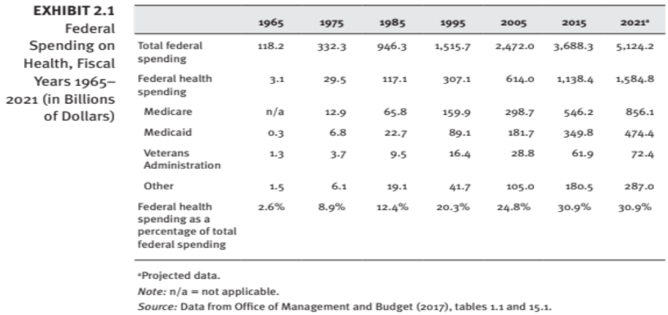
Federal Spending on Health, Fiscal Years 1965–2021 (in Billions of Dollars)
Exhibit 2.1

Slide 7
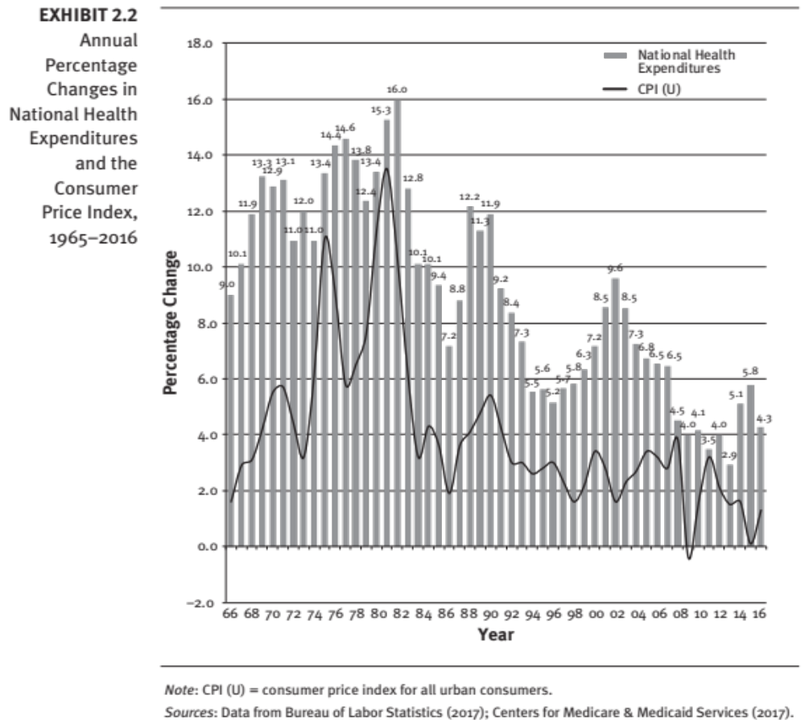
Exhibit 2.2
Annual Percentage Changes in National Health Expenditures and the Consumer Price Index, 1965–2016
return to presentation

Slide 8
Chapter 2 How Must Should We
Spend on Medial Care?
Chapter Overview
The United States spends a greater portion of its Gross National Product (GDP) on medical care than any other country.
This expenditure is 17+ percent of GDP, and the percentage is expected to continue to increase.

Slide 9
Chapter 2 objectives (continued)
This chapter explains how inefficiencies in the use and provision of medical services have contributed to rising costs.
The chapter also discusses why increased expenditures are a cause for concern and what trade-offs will be necessary to limit increases in the future.
Finally, a key question is raised: who should decide how much is to be spent on medical care?

Slide 10
Some Highlights – Chapter 2
In a competitive market, consumers influence these decisions through their expenditures, which communicate their values in terms of the goods and services they wish to consume.
Some people believe that consumer sovereignty should not be the basis for how much is spent on medical care because, compared to consumers of other goods and services, patients lack information and have limited ability to judge needs for medical treatment.

Slide 11
Some Highlights – Chapter 2
For large employers, spending on health insurance premiums has risen rapidly over time.
Government is concerned about rising medical expenditures because federal health spending, as a proportion of total federal spending, is increasing rapidly

Slide 12
How to limit increases in medical expenditures?
Government limits on medical expenditures (government)
Discounts on drug prices for seniors (consumers)
Less access to specialists (employers)

Slide 13
Discussion
Is consumer sovereignty the best way to determine how much we as a society spend on medical care? Why or why not? What are the advantages or disadvantages of alternative approaches, in your opinion?

Slide 14
Summary
Countries have answered the basic question, “Who should decide how much is to be spent on medical care?” in different ways:
  Government determines the allocation of resources and controls medical prices.
  Consumer sovereignty—i.e., consumers determine the amount of their income to be spent on medical services.

Slide 15
Summary (continued)
United States follows the consumer sovereignty approach
  (except for consumers enrolled in Medicare and Medicaid).

Slide 16
Summary (continued)
Yet consumers have not always received value for their money:
  Inefficiencies in the medical sector
  Inappropriate provider incentives
  Certain government regulations
  Subsidies for the purchase of health insurance that result in greater use of services

Slide 17
Summary (continued)
Debate over the appropriate amount to be spent on medical services is likely to be clarified once the issues of consumer sovereignty and efficiency of the current system are separated.

